Slide 1
Generation of Concept Cloud

Slide 2
Determining the semantic relatedness between two words refers to computing a statistical measure of similarity between those words.
For example, a biologist would classify a newly found animal specimen based upon the properties that it shares with existing categories of animals.

Slide 3
We can then make additional inferences on the new specimen using the properties known for the existing category. As the similarity between two objects X and Y increases, so does the probability of correctly inferring that Y has the property T upon knowing that X has T .

Slide 4
Semantic similarity is a generic issue in a variety of applications in the areas of computational linguistics and artificial intelligence, both in the academic community and industry.
Examples include word sense disambiguation, text segmentation, image retrieval, multimodal documents retrieval, and automatic hypertext linking. Similarity between two words is often represented by similarity between concepts associated with the two words

Slide 5
In information retrieval, similar or related words are used to expand user queries to improve recall.
In query expansion a user query is modified using synonymous words to improve the relevancy of the search.
One method to find appropriate words to include in a query is to compare the previous user queries using semantic similarity measures. If there exist a previous query that is semantically related to the current query, then it can be suggested either to the user or internally used by the search engine to modify the original query.

Slide 6
To decide whether two words are semantically similar, it is important to know the semantic relations that hold between the words.
For example, the words horse and cow can be considered semantically similar because both horses and cows are useful animals in agriculture. Similarly, a horse and a car can be considered semantically similar because cars, and historically horses, are used for transportation. Semantic relations such as X and Y are used in agriculture, or X and Y are used for transportation, exist between two words X and Y in these examples.

Slide 7

METHOD BASED ON JACCARD COEFFICIENT
The Jaccard coefficient is used to determine the similarity between two given sets, A and B, by taking the ratio between the size of the intersection of the two sets and the size of the union of the two sets i.e.
Jaccard(A,B) =

Slide 8

In web search the Jaccard can be reformulated as:
Jaccard(P,Q) =
Where H(P) and H(Q) refer to the number of pages(documents) retrieved for the word P and the word Q respectively, and H(PQ) refers to the number of pages(documents) in which word P and Q co-occur.

Slide 9
Proposed Method
Step 1: Pre-processing of input data
Stemming, Stop word removal, Frequency cutoff etc.
Step2: Semantically related terms extraction
Step 2.1: Generate binary occurrence matrix
Step 2.2: Calculate the Jaccard coefficient .
Step 2.3. Combine the semantically related terms on three different basis
Maximum Jaccard Coefficient
Average Jaccard Coefficient
Minimum Jaccard Coefficient

Slide 10
Step1: Preprocessing of Documents
Given below is list of 5 pre-processed documents on football news. The terms present in each document is given row- wise.
Documnet1:
[Coach, play, referee, goal, game, goal, mistake, linesman, referee, line, win, coach, mistake, unhappy]
Document2:
[score, goal, match, meet, World, Cup, quarter, final, win, goal, tournament, score, win, people ]
Document3:
[quarter, final, World, cup, ball, midfield, beat, hit, ball, score, goal, score, referee, offside]
Document4:
[World, Cup, quarter, final, score, goal, score, beat, team, extra, time, referee, score, quarter, game, win, final]
Document5:
[World, Cup, game, lose, win, tournament, match, goal, team, lose, semi, final, World, Cup, tournament, win, game, semi final]

Slide 11

Step 1: The list of distinct terms in all five documents
[Coach, play, referee, game, mistake, ball, win, World, Cup, quarter, final, tournament, team, extra, time, win, line, meet, score, lose, semi, people, match, unhappy linesman]
After removing those terms that have less than 2 occurrences in all documents, the list is
[Referee, World, cup, tournament, quarter, final, score, win, game, goal]
Generate binary occurrence matrix B of size m×n where each element b_{ij} contains a binary indicator whether the term t_{j} is present in document d_{i} or not i.e.
b_{ij} =

Slide 12


B =
Calculate the Jaccard coefficient for each pair of terms
Jaccard(t₁,t₂) =
H(t₁) = number of occurrences of term t₁ in all five documents =3
H(t₂) = number of occurrences of term t₂ in all five documents =4
H = number of co-occurrences of term t₁ and t₂ in all five documents = 2

Slide 13

Jaccard(t₁,t₂) = = 0.40

Slide 14
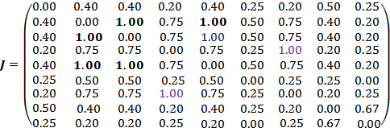
Jaccard Coefficient for all pair of distinct term can be calculated and represented by matrix J of size n×n

Slide 15
Combine the pair of terms using, Maximum Jaccard coefficient.
Semantically Related terms
1.00
world, cup
1.00
quarter, score
1.00
final, world, cup
0.75
quarter, score, final, world, cup
0.67
win, game
0.50
Referee, win, game
0.25
tournament, Referee, win, game

Slide 16
Using Maximum Correlation coefficient of pattern length 3
Patterns Maximum Correlation
0.84
shot, cross, touch
0.76
area, hit, net
0.62
goalkeeper, chance, pass
0.59
referee, replays, offside
0.59
appearance, kick, post
0.58
scoring, goals, record
0.52
pressure, goal, crossbar

Slide 17
Using Maximum Correlation coefficient of pattern length 4
Maximum Correlation | Patterns
0.83 | hit, shot, cross, touch
0.60 | kick, post, substitute, effort
0.49 | bar, goalkeeper, chance, pass
0.40 | opening, referee, replays, offside
0.39 | stage, winner, coach, midfield
0.43 | press, media, field, reporters

Slide 18
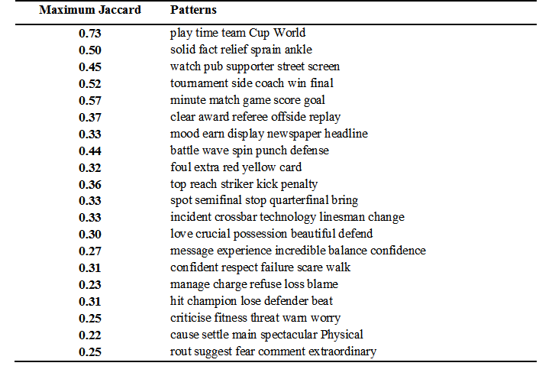
Generated Concept clouds Using Maximum Jaccard coefficient (No of unique words 800, no of documents 100)

Slide 19
COMPUTATION OF THE SEMANTIC RELATEDNESS BETWEEN WORDS USING CONCEPT CLOUDS

Slide 22
Input Pre-Processor
The Input Pre-Processor module takes the given word pair as input and divides it into two separate words. Each word is then pre-processed by converting it to lower case letters. Furthermore, any special characters such as “@”, if present, are removed from the words. Finally, the two words are provided as input to the concept extractor (one at a time).

Slide 23
Concept Extractor
The Concept Extractor module takes as input words from the Input Pre-Processor module and, for each word, it extracts its related concepts and forms the concept cloud by including the top k related concepts.
In this example, we use the top five related concepts to generate the concept cloud of a term. Please note that before generating the concept cloud, we perform a filtering of the related concepts. Filtering involves removal of long concepts (more than 3 words), concepts containing special characters such as “@”, and general concepts such as dictionary, web, etc.

Slide 24
Cloud Comparator
The function of the Cloud Comparator module is to perform a statistical comparison of the concept clouds corresponding to two words, using web based coefficients such as Jaccard coefficients.
To achieve that, the Cloud Comparator computes a statistical
similarity measure between all pairs of concepts < A;B >, where A belongs to the cloud of one term and B belongs to the cloud of the second term, and calculates the average of all similarity scores to determine the relatedness between the original words.

Slide 25
To compute the relatedness between a term i from
the first concept cloud A, denoted conA(i), and the
second concept cloud B, we compute the Jaccard’s coefficient between conA(i) and all concepts conB( j) in the concept cloud B and then take the average of all scores obtained.

